Slide 1

Engineering Economics &
Management
PREPARED BY- AHIR NIXIT C.
ENROLLMENT NO.- 160410116004
BRANCH- IT 1
BATCH-A

Slide 2
COST
An amount that has to be paid or given up in order to get something.
In order to make use of the various factor and non-factor inputs.
In common, the amount spend on these inputs is called the cost of production.

Slide 3
CONCEPT OF COST
MONEY COST :
The amount spend in terms of money for the production of the commodity is known as money cost .
NOMINAL COST:
It is the money cost of production.
REAL COST :
It is the mental, physical and sacrifices undergone with a view to producing a commodity .

Slide 4
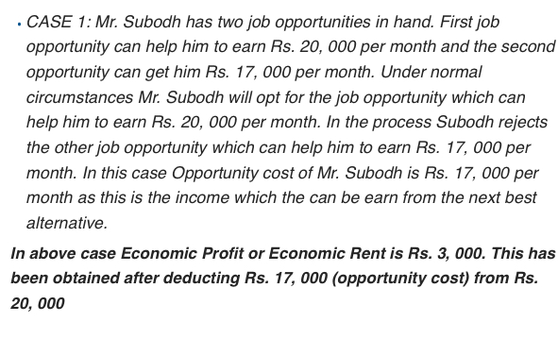
OPPORTUNITY COST :
The opportunity cost, also known as alternative cost, is the value of the choice of a best alternative cost while making a decision.

Slide 5
IMPLICIT COST :
It is the cost of self-owned resources such as salary of proprietor.
EXPLICIT COST :
* It is the paid-out cost.
* It means payments made for the productive resources purchased.

Slide 6
ACCOUNTING OR BUSINESS COST:
Cash payments which firms make for factor and non-factor input depreciation other book keeping entries.
SOCIAL COST:
It is the amount of cost the society bears due to industrialization.
ENTREPRENEUR’S COST:
The cost of production in the sense of money cost or expenses of production.

Slide 7
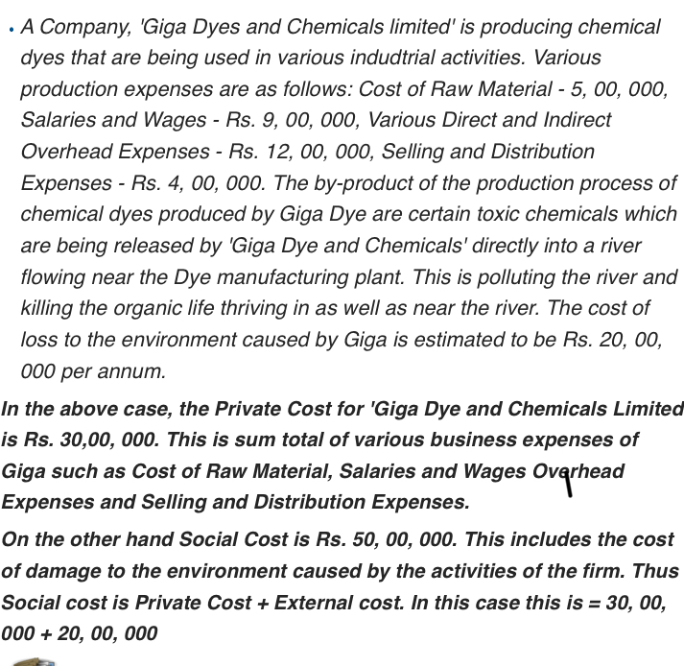

Slide 8
CLASSIFICATION OF ENTREPREUNER’S COST
PRODUTION COST.
SELLING COST.
OTHER COST.
MANAGERIAL COST.

Slide 9
ELEMENTS
WAGES.
INTEREST.
RENT.
COST OF RAW MATERIALS.
REPLACEMENT AND REPAIRING.
DEPRICIATION.
PROFITS.

Slide 10
SHORT-RUN COSTS
In the short run atleast one factor of production is fixed.
Output can be varied only by adding more variable factors.

Slide 11
PRIME COSTS:
Some costs vary more proportionately with the output,while others are fixed and do not vary output in the same way.
SUPPLEMENTARY COSTS:
Some costs vary less proportionately with the output,while others are fixed and do not vary output in the same way.

Slide 12
FIXED COST
Remains constant.
Also known as short-run cost.
This cost includes:
*Cost on managerial staff.
*Expenditure on depeciation.
*Maintenance cost of the factory.

Slide 13
VARIABLE COST
Vary directly with the level of output
Used in the actual production process.
Functions of output changes.
Eg: Cost of raw-materials.
Cost in direct labour.

Slide 14
TOTAL COST:
Sum of total fixed cost and total variable cost.
TC=TVC+TFC.
TVC=0, when the output is zero and increases with increase in the output.

Slide 15
AVERAGE COST
They are of three types.
*Average fixed cost.
*Average variable cost.
*Average total cost.

Slide 16
AVERAGE FIXED COST:
It is the per-unit cost of the fixed factors.
AFC=TFC/Q.
AVERAGE VARIABLE COST:
It is the per-unit cost of the variable factors.
AVC=TVC/Q.

Slide 17
AVERAGE TOTAL COST
* It is the total cost divided by the number of units produced.
* Sum of average fixed cost and average variable cost.
ATC=TC/Q.
AC=AFC+AVC.

Slide 18
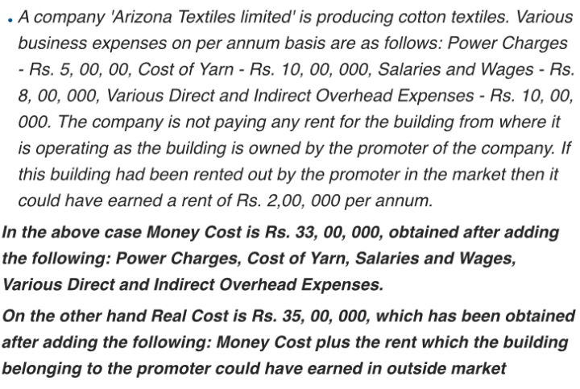

Slide 19
THANK U

